Slide 1
Benchmarking GPU with DL Models
CMPE-214 Term Project
Sai Kashyap K.
Akash M.

Slide 2
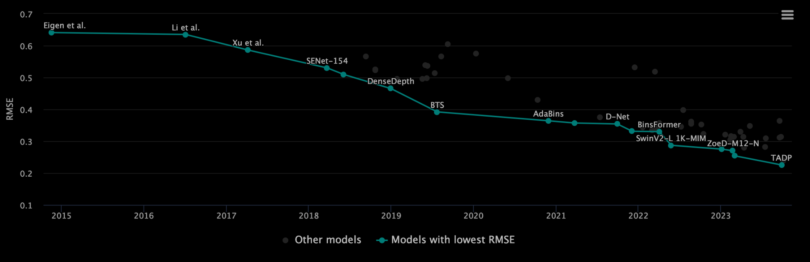
Benchmarking
Process of evaluating and comparing the performance of various deep learning models or algorithms using standardized datasets and metrics.
Vendor wouldn’t directly tell us architecture details.
Notes:
Stressing certain part of the hardware for specific application which can help discern app behavior and architecture characteristics
Gpu_tot_ipc, L1_cache_miss_rate, L2_cache_miss_rate, bw_utilization from Lab5
Gaming:
Benchmarking Metric: Frames Per Second (FPS) in popular game titles.
Example: If you're building a gaming PC, benchmarking GPUs using gaming benchmarks (e.g., 3DMark, game-specific benchmarks) helps determine which GPU delivers the desired FPS for your favorite games at the desired resolution and settings.
Deep Learning (AI/ML):
Benchmarking Metric: Throughput in operations per second for deep learning frameworks.
Example: If you are training large neural networks, benchmarking GPUs with deep learning workloads using frameworks like TensorFlow or PyTorch can help identify the GPU that offers the best performance for your specific neural network architecture.
Video Editing:
Benchmarking Metric: Rendering time for video editing tasks.
Example: Video editing software often utilizes GPU acceleration for tasks like rendering and effects. Benchmarking GPUs with video editing workloads (e.g., Adobe Premiere Pro benchmarks) helps choose a GPU that significantly reduces rendering times for your video editing projects.
3D Rendering and Modeling:
Benchmarking Metric: Rendering time in 3D modeling and rendering applications.
Example: Professionals in fields like architecture or animation may use benchmarking tools specific to 3D rendering software (e.g., Blender benchmarks) to select a GPU that accelerates the rendering process for complex 3D scenes.
Scientific Computing:
Benchmarking Metric: Performance in scientific computing workloads.
Example: Researchers or scientists may benchmark GPUs using scientific computing tasks, such as simulations or numerical simulations. The choice of GPU depends on its performance in handling specific scientific computing algorithms.
Image Processing:
Benchmarking Metric: Throughput in image processing tasks.
Example: Benchmarking GPUs with image processing workloads (e.g., medical image analysis or computer vision tasks) helps identify the GPU that provides the best performance for manipulating and processing images quickly and efficiently.
CAD (Computer-Aided Design):
Benchmarking Metric: Performance in CAD applications, especially during complex model manipulation.
Example: CAD professionals may use benchmarks that simulate real-world CAD tasks to choose a GPU that enhances the fluidity and responsiveness of their design workflows.
Blockchain and Cryptocurrency Mining:
Benchmarking Metric: Hash rate in cryptocurrency mining algorithms.
Example: Crypto miners can benchmark GPUs using mining algorithms to determine which GPU offers the best hash rate for specific cryptocurrencies, influencing their decision on hardware for mining operations.

Slide 3
Benchmark suites
What is a Benchmark suite ??
Standardized tests and tools designed to evaluate and compare the performance of GPUs under various workloads.
A well-designed benchmark suite can cover a range of performance metrics and workloads, offering
Insights into a GPUs strengths and weaknesses across different type of applications
Some widely used GPU benchmark suites are 3DMark, FurMark, SPECviewperf, Tensorflow , OpenCV, Pytorch, MLPerf .etc…
Notes:
Single run
GPU benchmark suites are essential for assessing the capabilities of different GPUs and understanding their performance in specific computational tasks, such as deep learning, gaming, and high-performance computing.
The purpose of a benchmark suite is to provide a comprehensive evaluation of a GPU's capabilities, allowing users to compare different GPU models or architectures under consistent testing conditions
GPU benchmark suites are widely used by gamers, content creators, and professionals in industries such as animation, visual effects, and scientific research to ensure optimal GPU performance and productivity.

Slide 4
Motivation
Assess Model Performance: To determine how well a model performs on specific tasks.
Enable Fair Comparisons: Provides a common ground for comparing models objectively.
Track Progress: Monitors advancements in deep learning research. Also helps the deep learning community build on your research.
Different ML systems prioritize latency, throughput, power consumption, and model quality in various ways during inference. This leads to a wide array of possible combinations of tasks, models, datasets, frameworks, libraries, and inference engines, making it challenging to evaluate inference performance comprehensively.

Slide 5
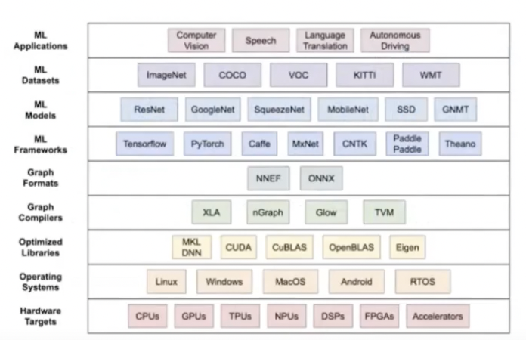
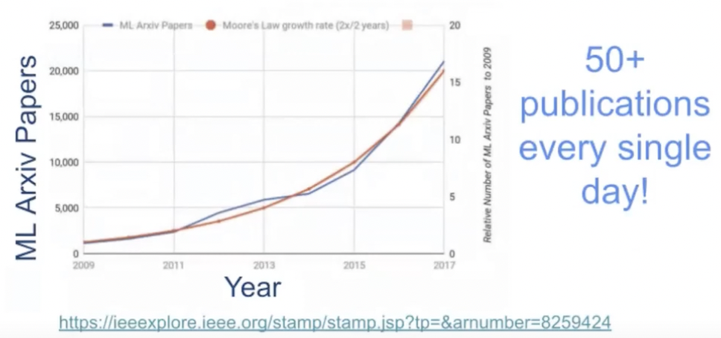
Why Benchmark Machine Learning Systems
Machine Learning needs the entire software stack and hardware working seamlessly together.
Exponential growth in research and innovation.
ML inference has become a critical workload, with models handling a massive number of queries and translations daily. To meet the growing computational demands, developers have focused on optimizing ML hardware and software.

Slide 6
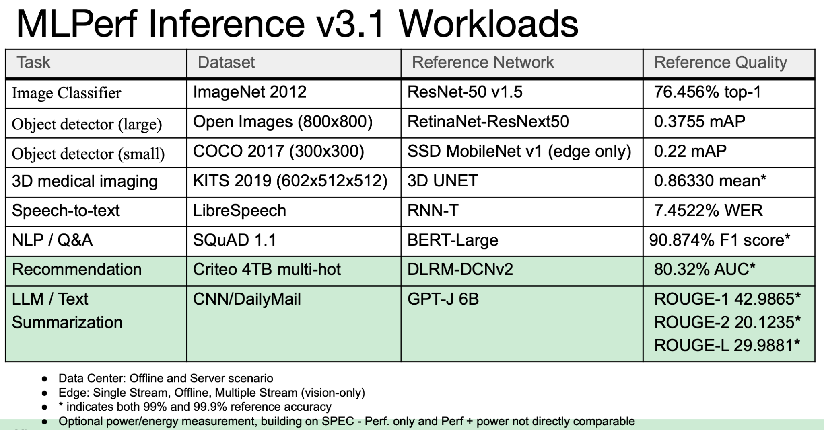

Slide 7
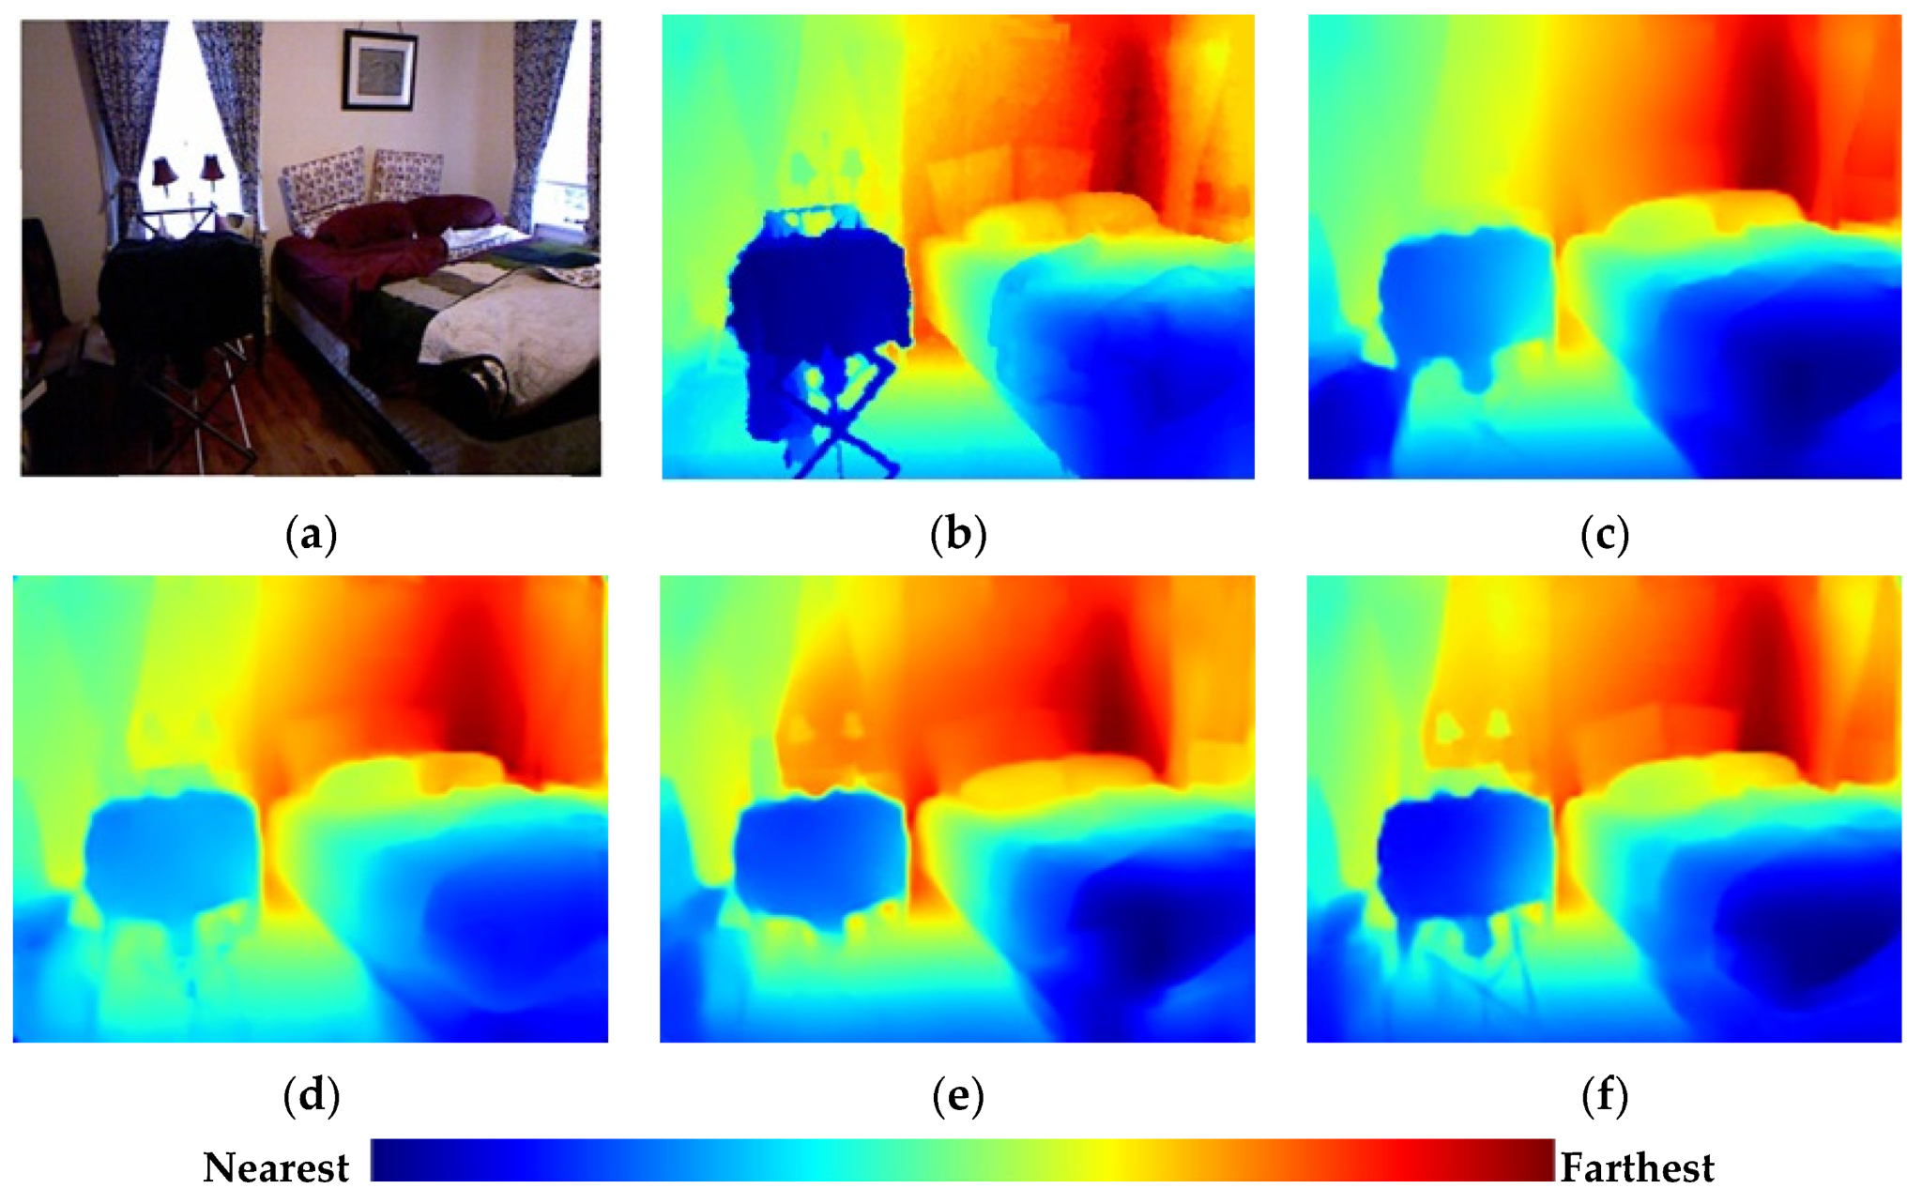
Monocular Depth Estimation
Definition: Inferring scene depth from a single 2D image.
Applications: Vital for autonomous vehicles, AR/VR, robotics, and more.
Methods: Traditional (Stereo, SfM) vs. Deep Learning (CNNs).
Metrics: MAE, RMSE, Silog Error for evaluation.
Future: Improve robustness, real-time performance, multimodal sensing.

Slide 8
Proposed Work
The MLCommons MLPerf Inference benchmark suite measures how fast systems can run models in a variety of deployment scenarios.
ML WorkLoads (Inference) for Computer Vision - Image Classification, Object Detection, Semantic Segmentation, Instance Segmentation, Image Generation, Object Tracking.
Workflow -> Prepare Your System, Set Up the Benchmark, Run the Benchmark, Validate and Review, Submit Results, Compliance Check, Peer Review, Publication and Participation Rules
Try similar for Depth Estimation Task but focused on single GPU task and PyTorch Library.
Changed to Math models that can be applied irrespective of ML models.
Convenience tool for people to utilize, for e.g. scripts from Github.

Slide 9
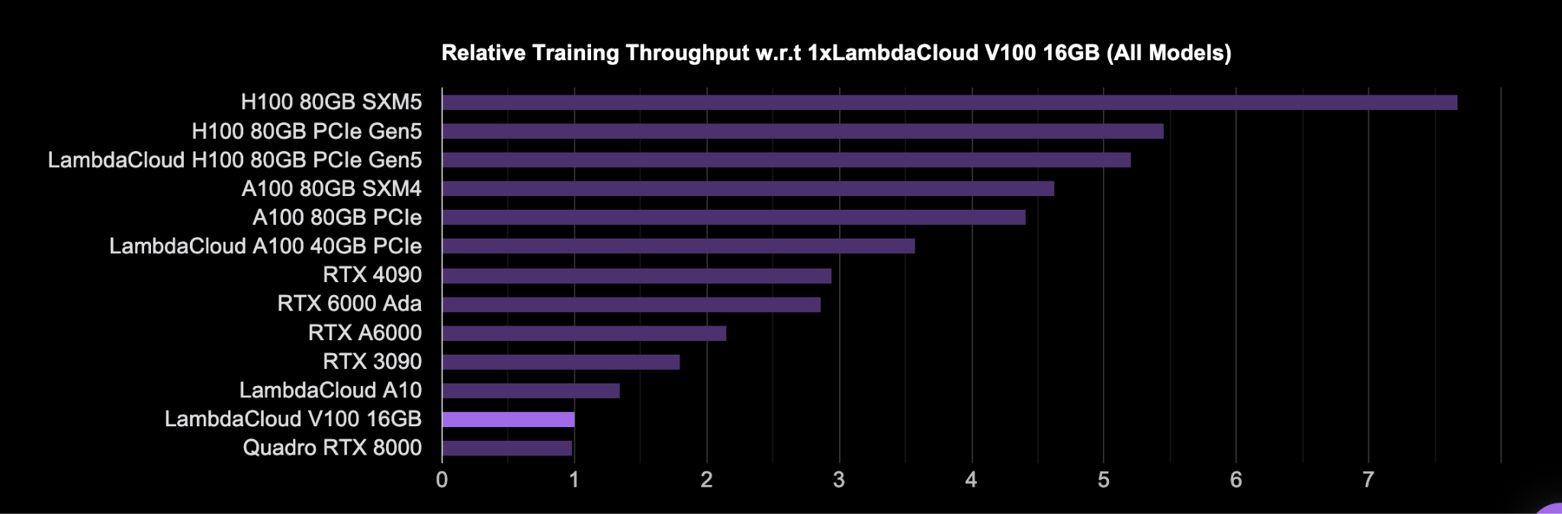
Progress:
MLPerf: Macro-benchmarking a collection is a seemingly arbitrary collection of DNNs models which are not flexible enough to take any model; not parameterised.
New versions come after half an year of development and months to add a new model which may not exist for long.
Recreate Lambda Labs benchmarking tool:

Slide 10
Issues
MLPerf optimized models which Lambda did not; kind of averaging process and representative of average application run.
But averaging is not problem specific like MLPerf.
Containerized benchmarks for NVIDIA examples. no longer supported. Same problem as with MLPerf.
Explored ParaDNN tool which generates thousands of parameterised multi-layered models - David Brooks
Current: Implementing any model without ‘any’ optimization - throughput, time to solution, maximum batch input size.
Use standard YOLO implementation for object detection NOT monoscopic depth estimation.

